Slide 1
RTGI using rasterization
Che Sun

Slide 2
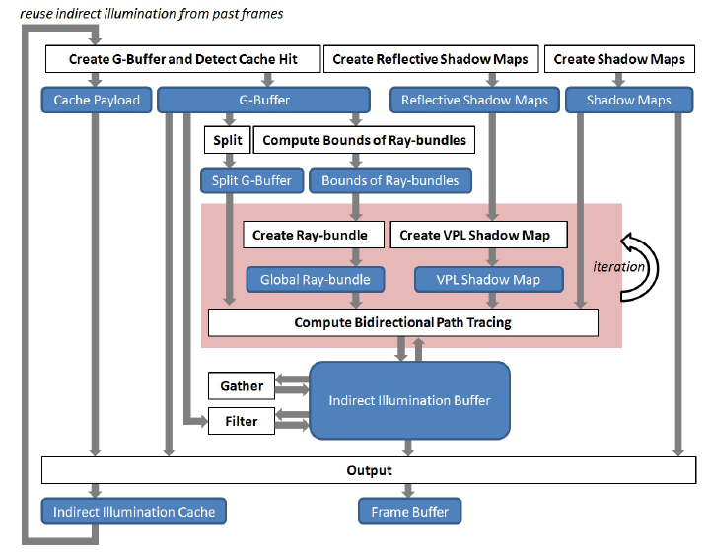
System Architecture

Slide 3
Hierarchical View of Technique Dependencies
Voxel-based Hybrid RTGI
Sampling and Reconstruction
Indirect Illumination
Direct Illumination
Interleaved Sampling
Frame Coherence Cache
Bidirectional Path Tracing
Direct Shadow using Rasterization (Regular Shadow Maps)
Direct Lighting Deferred Shading
G-Buffer Split
Instant Radiosity using Rasterization
Global Ray-bundles using Rasterization
Paraboloid Mapping
G-Buffer Creation
Scene Light RSMs Creation
Ray-bundles BV Computation using Compute Shader
Ray-bundles Creation and Shading
Caustics Maps
Indirect Illumination Buffer Creation and Filtering
VPL Creation and Shading
GPU Concurrent Linked List
VPL Visibility Test
Voxel-based Ray-bundles
Shader Atomic Operations
Shader Generic
Buffer
VPL Shadow Maps (Paraboloid Mapping)
Scene Voxelization
Implemented techniques
Scene Geometry Tesselation
Sparse Voxel Octree
Regular Voxelization
Unimplemented techniques
System Bottle Necks
Our Improvements

